Slide 1




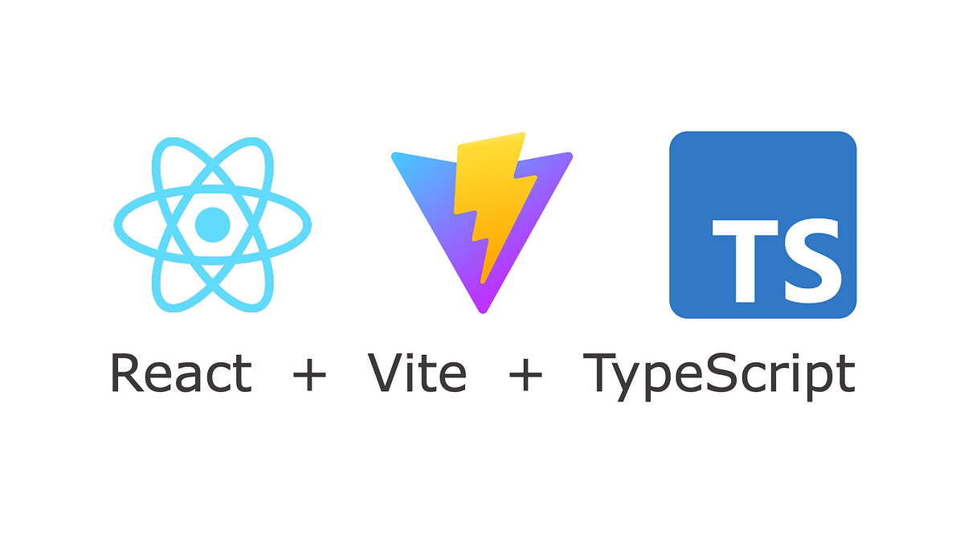


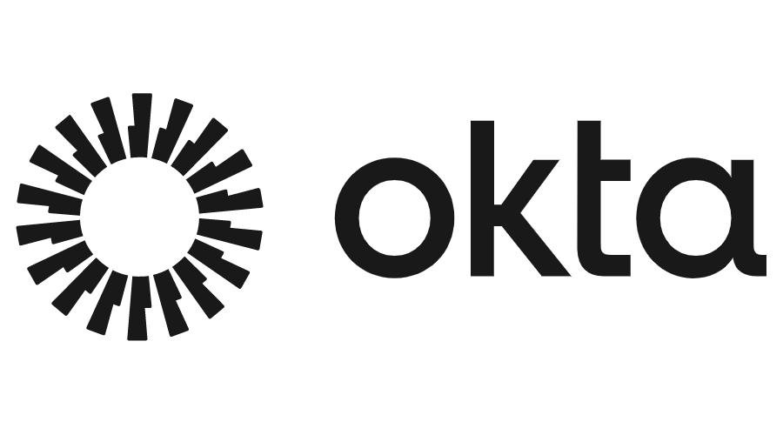

Revolutionizing GPT3.5 Turbo Language Translation
A Glimpse into My Innovative AI-Powered Application
I this increasing interconnected world, effective communication across languages is paramount.
My project, the GPT3.5 LTA addresses this need by harnessing the power of advanced natural language processing techniques. Through the integration of cutting-edge technologies such as GPT-3.5 Turbo and AI, the application offers simple, fast, and contextual precise language translation capabilities.
By leveraging state-of-the-art machine learning models and innovative design principles, The GPT 3.5 LTA aims to break down language barriers, increase cross-cultural understanding, and facilitate global communication. Join me in exploring the future of language translation at the virtual degree show exhibit.
Key features
Fast and precise language translation using GPT-3.5 Turbo.
Vocal recognition for effortless input of text.
Intuitive user interface for enhanced user experience.
Secure authentication and access management with Firebase.
Integration with cloud services for scalability and reliability.
Benefits
Unmatched Accuracy
Natural Language Understanding
Rapid Responses
Empowering Communication
Continuous Improvement
For Enquiries or Collaboration Contact me at Rayan2.Louahche@live.uwe.ac.uk
Software Development Project UFCFFF-30-3

